Slide 1
In Search of an SRN in the Canonical Microcircuit, or… Me just tryin’ to understand…
Thomas E. Hazy
June 18, 2013

Slide 2
Agenda
Background & Motivation
SOCO/Take Home Message
Not layer 6
Maybe layer 5a?
Discussion & FEF/PBWM wishlist
References

Slide 3
References
Layer 5a/b:
MannsSakmannBrecht04
SchubertStaigerChoEtal01
SchubertKotterLuhmannEtAl06
SchubertKotterStaiger07
WesterContreras12
Layer 6:
MercerWestMorrisEtAl05 (Thomson)
Thomson10
ZarrinparCalloway06

Slide 4
Background
LeabraTI needs an SRN mechanism
The canonical cortical microcircuit

Slide 5
The canonical microcircuit
Layer 2/3
Layer 4
Layers 5 & 6
Thalamus
IN
OUT

Slide 6
S.O.C.O
“Instead of layer 6, layer 5a may be the best candidate for an SRN-like function for the canonical microcircuit.”

Slide 7
Why not layer 6?
Which answer do we want?
Short?
Or long?

Slide 8
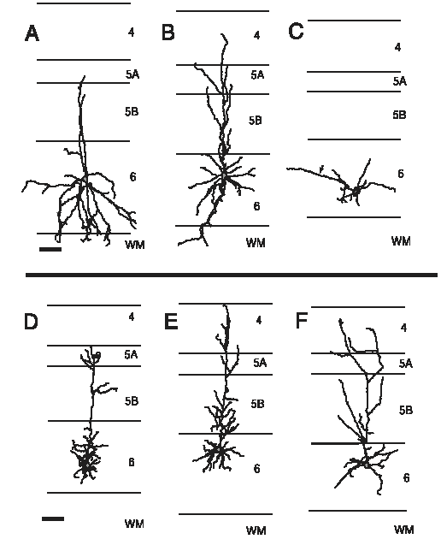
Not 6…
Six (7?) subtypes:
One inhbitory interneuron (A)
Two corticothalamic (D,E)
Three corticocortical (B,C,F)
One claustrum-projecting (not shown; Thomson10)
From ZarrinparCalloway06

Slide 9
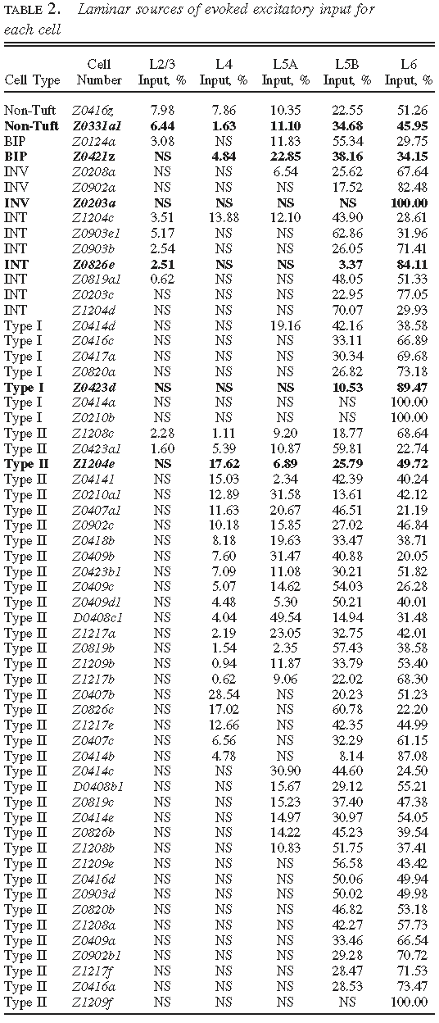
Not 6…
~75% of pyramidals are “typical” corticothalamic
~13.5% “atypical” corticothalamic
~11.5% corticocortical
From ZarrinparCalloway06

Slide 10
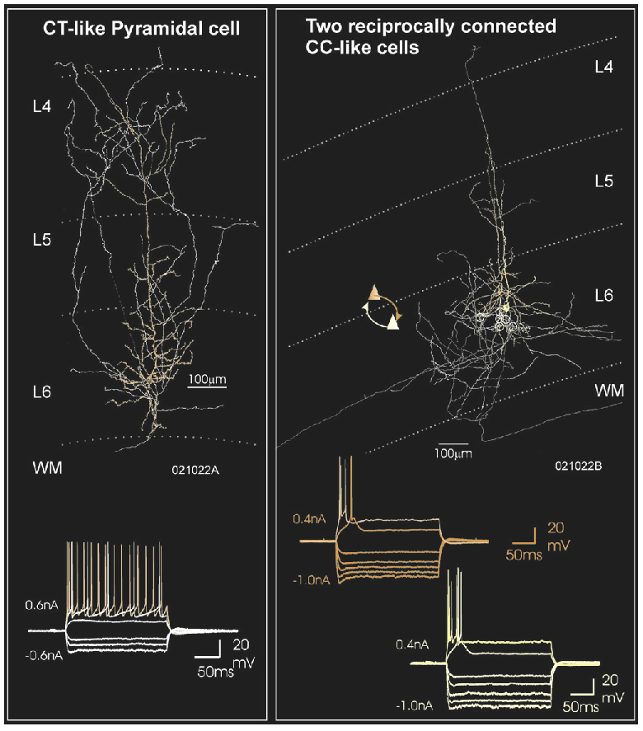
Not 6…
Corticocortical (right) fire only phasically to sustained input
Corticothalamic fire in a sustained manner
From MercerWestMorrisEtAl05

Slide 11
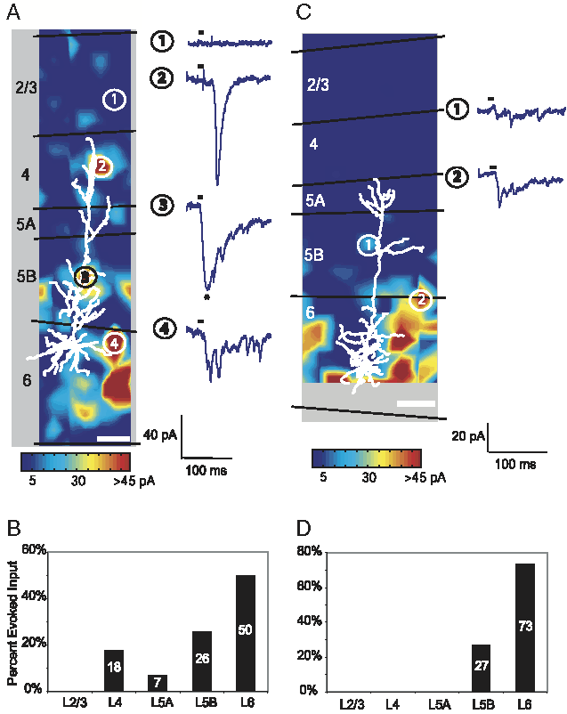
Not 6…
Layer 6 dominates input to atypical cortico-thalamic guys (right)
Corticothalamic are up to 4X less likely than cortico-cortical to be pre-synaptic to other layer 5 & 6 guys
From ZarrinparCalloway06

Slide 12
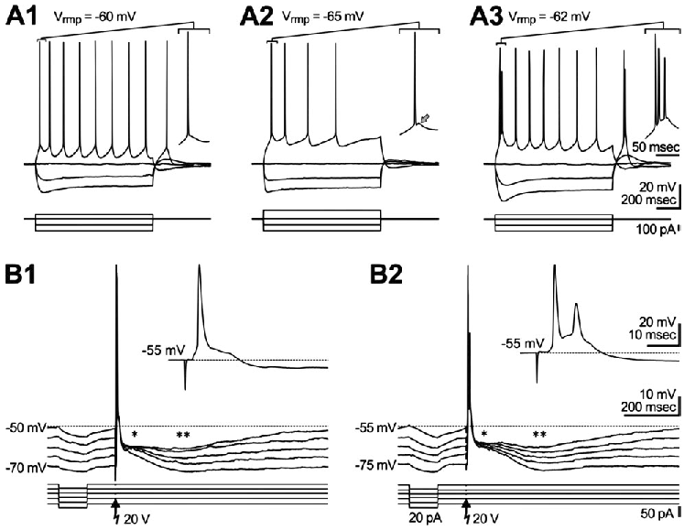
Maybe 5a?
Layer 5a two cell types?:
Regular spiking (RS; dominant)
Intrinsic bursting (IB)
NOTE: “Bursts” of 2-3 spikes only at initial response, followed by single spikes, in response to current injection.
Figure 2. Electrophysiology of layer Va pyramidal neurons. (A) Whole cell recordings at resting membrane potential in current clamp mode with hyper- and suprathreshold depolarizing current injection. In each recording the initial action potentials are given in an enlarged view on the right. (A1, A2) Pyramidal neurons showing a regular spiking (RS) pattern upon suprathreshold current injection. (A1) RS pyramidal cell without a depolarizing afterpotential (DAP). (A2) RS pyramidal cell with initial action potential (AP) followed by a small DAP (arrow). (A3) Pyramidal cell showing intrinsically burst firing (IB) pattern. The initial high frequency burst consists of three APs riding on a strong DAP. (B) Postsynaptic responses of an RS (B1) and an IB (B2) pyramidal cell following orthodromic electrical stimulation at different membrane potentials. The stimulus induced an initial EPSP, eliciting AP firing, followed by a fast (asterisk) and a slow IPSP (double asterisk). The enlarged view illustrates the latency of the response at a holding membrane potential of -55 mV. From SchubertKotterLuhmannEtAl06.

Slide 13
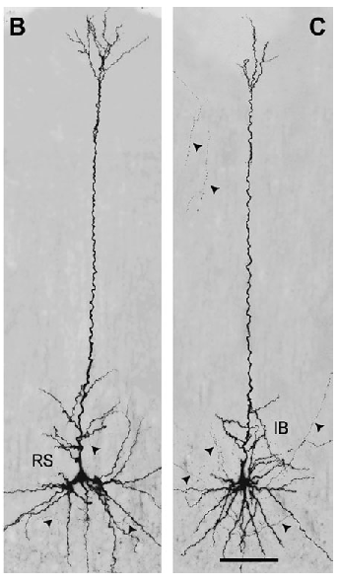
Maybe 5a?
No statistical difference found in morphological or functional measures between RS (n = 18) and IB (n = 10) pyramidals, so treated as a homogeneous population.
^{Figure 3B,C} from SchubertKotterLuhmannEtAl06.

Slide 14
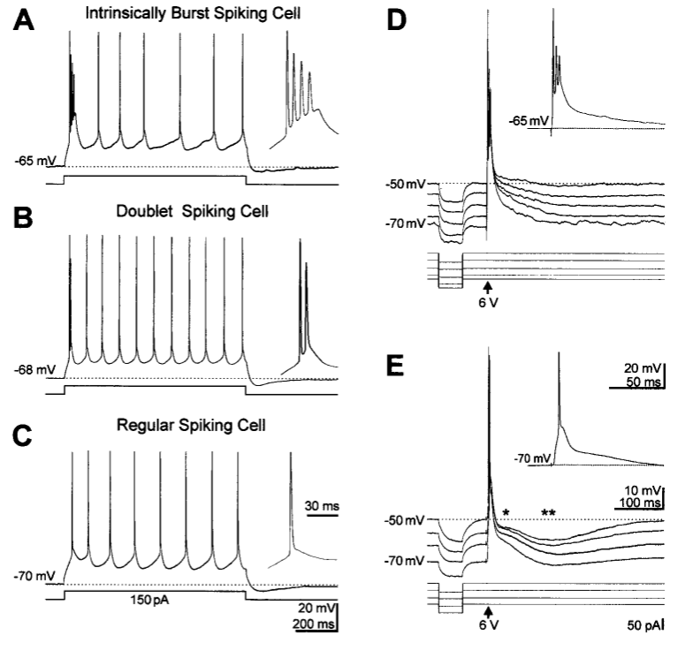
Maybe 5a?
ASIDE: Layer 5b also has two cell types:
Intrinsic bursting (IB)
Regular spiking (RS)
Again, the IB cells show “regular” firing after an initial burst.
^{From SchubertStaigerChoEtAl01.}

Slide 15
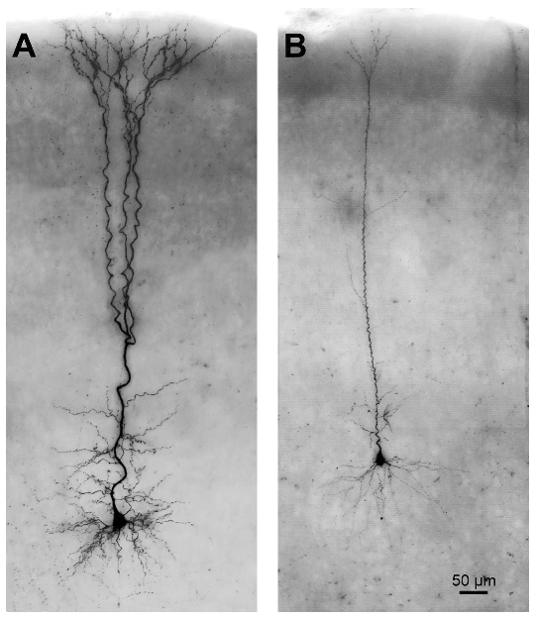
Maybe 5a?
In stark contrast to layer 5a, there is a clear statistical difference in morphological parameters between RS (n = 7) and IB (n = 5) pyramidal cells.
RS (both 5b and all 5a?) are up to an order of magnitude more likely to be pre-synaptic onto the large, projecting 5b-IB cells than vice versa. I.e., there seems to be a clear directionality between layer 5b-IB guys and everyone else.
Figure 3 from SchubertStaigerChoEtAl01.

Slide 16
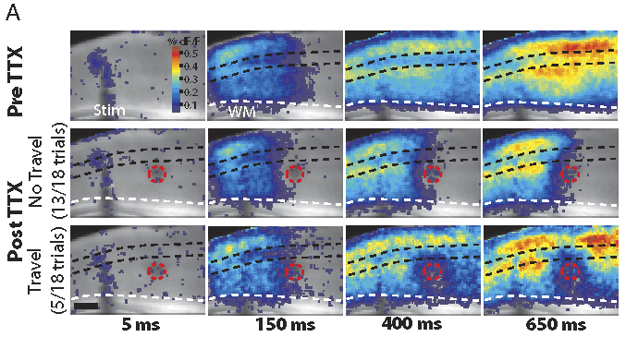
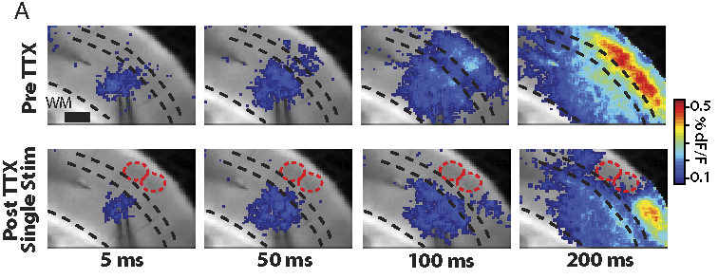
Maybe 5a?
Layer 5 blockade often halts propagation of spreading Up-states
Layer 5a has densest recurrent connectivity
Strong Layer 5a -> 2/3 prjn.
Excitation of layer 5 can always propagate past layer 2/3 blockade
Density of layer 2/3 recurrent connections < layer 5a
P(connectivity) falls off 10-fold over < 150 microns
From WesterContreras12

Slide 17
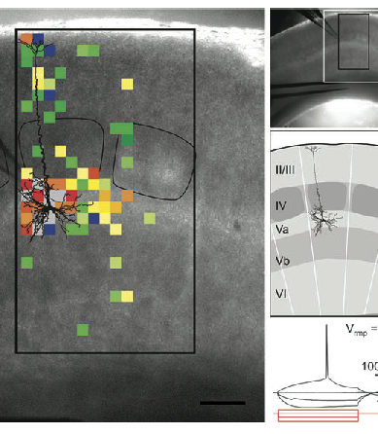
Maybe 5a?
Sources of afferent input to a layer 5a cell (blue = inhibitory)
Fm SchubertKotterLuhmannEtAl06

Slide 18
Maybe 5a?
From MannsSakmannBrecht04:
Fig 7 – Anatomically coupled 5a & 5b receptive fields (RFs)
Fig 3 – 5a RFs, dendritic, axonal length
Fig 4 – 5b RFs, dendritic, axonal length
Fig 9 – time course of RFs
Fig 10 – 5a,5b PSTH
Fig 12A,B – 5a vs. 5b EPSP summation

Slide 19
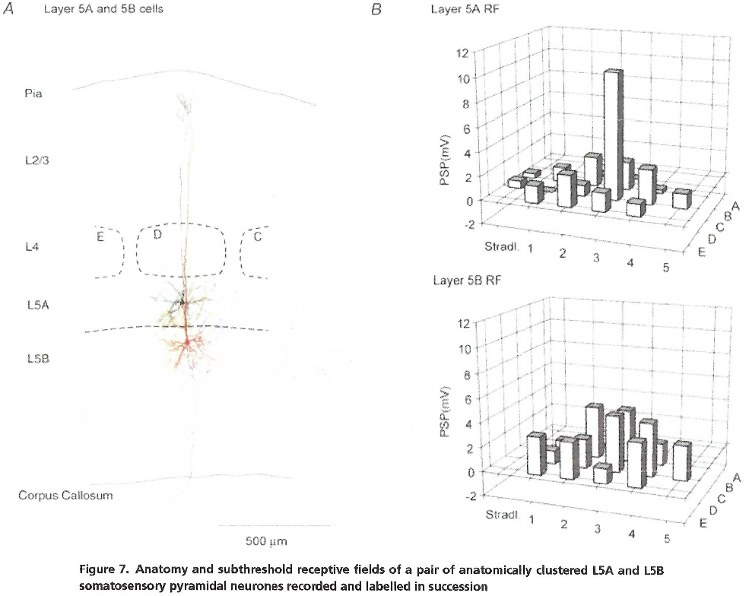
Maybe 5a?
From MannsSakmannBrecht04

Slide 20
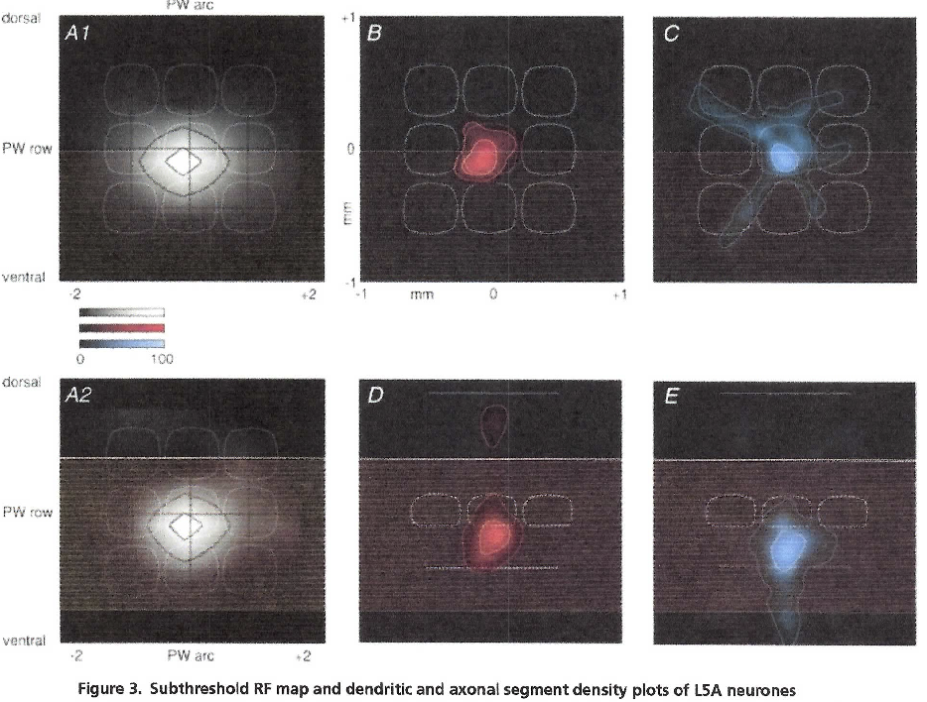
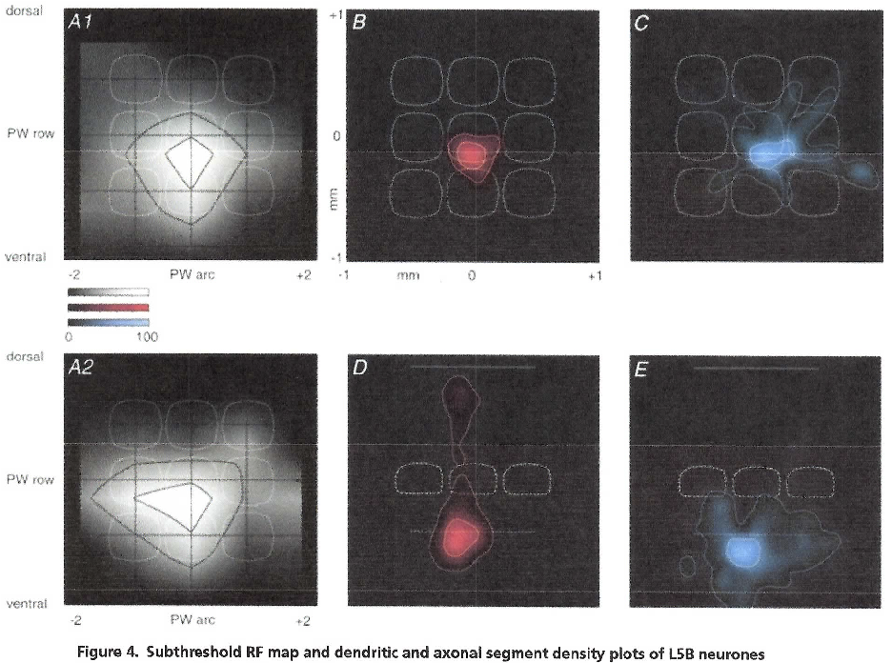
Maybe 5a?
From MannsSakmannBrecht04

Slide 21
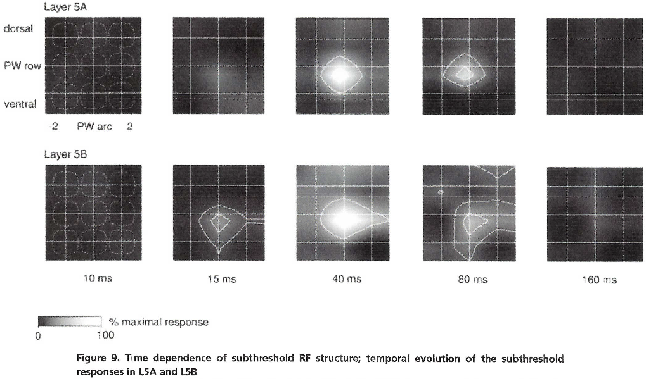
Maybe 5a?
From MannsSakmannBrecht04

Slide 22
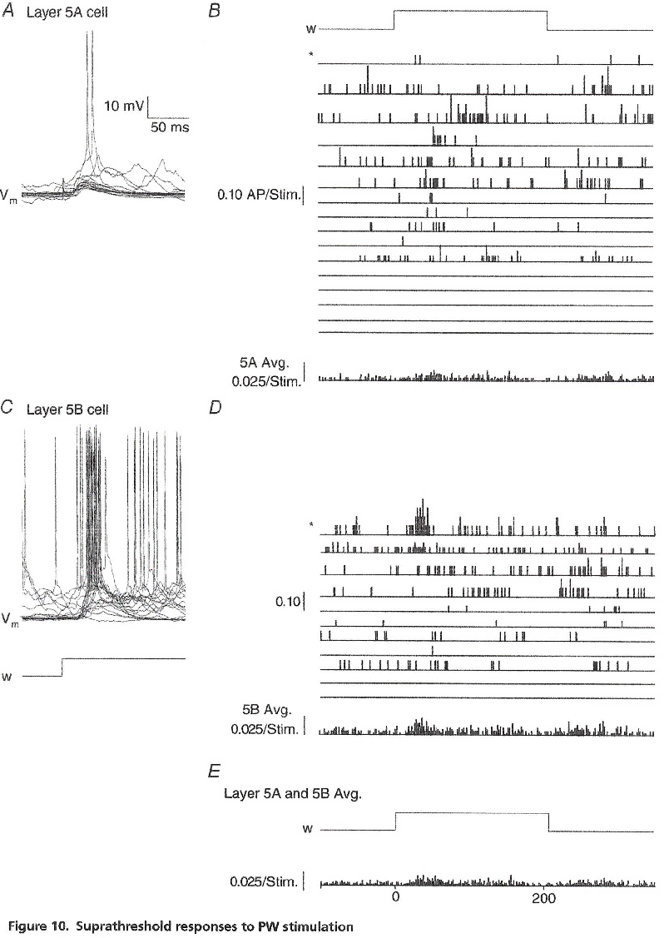
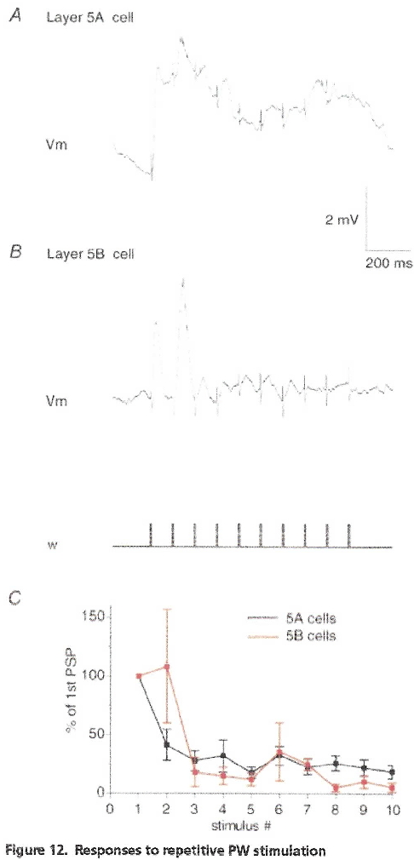
Maybe 5a?
From MannsSakmannBrecht04

Slide 23
SRN-ized canonical microcircuit
Layer 2/3
Layer 4
Layer 5a
Layer 5b
Layer 6
Thalamus
IN
OUT

Slide 24
References
Layer 5a/b:
MannsSakmannBrecht04
SchubertStaigerChoEtal01
SchubertKotterLuhmannEtAl06
SchubertKotterStaiger07
WesterContreras12
Layer 6:
MercerWestMorrisEtAl05 (Thomson)
Thomson10
ZarrinparCalloway06

Slide 25
Discussion/PBWM Wishlist
NEED PFCDeepGatedConSpec to get 5b reps downstream
MatrixLayerSpec.refract_inhib NOT working
NEED PFC_in/_out layer types to have obligatory carryover of activation through one full additional trial; not sure how this jives with new gate-effects-only-after-plus regime
There is really no option to not use TI for PBWM models, since it now supplies the maintenance machinery
STILL NEED pre- vs. post-gated activity levels for superficial layers
Since PFCdeep (5b) reps are NOT context, current fully integrated reps, we need still a third act variable, e.g., act_deep; alternately, is probably near enough to the superficial rep to use that, but then we need one pre- and and two post-gated supragranular act levels.
Does the netin calculation have a hard normalizing w/ the PFCTIConSpec?
Get some warning re: matrix layer send units out of range (marker cons)

Slide 26
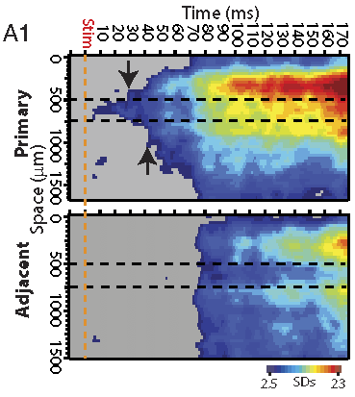
FYI…
Analysis and quantification of thalamocortical responses recorded with VSD imaging. A, Line profiles and ROI analyses for the slice in Figure 2. A1, Line profiles through the primary (top) and adjacent (bottom) columns. The 0 􏰌m represents the start of the line at the surface of the slice, and time represents the time poststimulation. The borders of L4 are bracketed by the dashed black lines and are based on measured depth from the surface. The downward arrow in the primary column line profile indicates activity invading L2/3, and the upward arrow indicates activity invading L5. The up-state travels as a wave with a single front to the adjacent column. A2, ROIs through the primary (top) and adjacent (bottom) columns. The black dashed line indicates the baseline, and the red dashed line indicates 2 SDs above baseline noise. The time to 2 SDs above baseline noise is indicated with colored dots for each ROI. The placement of line profiles and ROIs is shown over a grayscale reference image. Time of VB stimulation is marked by the dashed orange lines in all. B, Examples from two additional slices of up-state initiation in a primary column. ROIs were taken perpendicular to the surface of the slice as in part A, here centered on the site of the intracellular recording. A L2/3 cell was recorded in the top example, and a L5 cell was recorded in the bottom example. An expansion of the initial part of the response is provided at right. The time to 2 SDs above baseline noise is indicated with dots for each ROI. Note in both cases that a L4 3 L2/3 3 L5 order of activation of the primary column is apparent. Also note agreement of intracellular and VSD recordings. ROIs are from averages of multiple trials, while the intracellular recording is a representative single trial. C, Quantification of the order of activation of signals from ROIs representing cortical layers for a population of slices (n 􏰅 18). The y-axis represents the time from VB stimulation to dF/F signal crossing a threshold above baseline noise (2 SDs for initial response or 5 SDs for an up-state in progress), normalized to the time measured in L2/3. Individual trials are shown in gray, and the mean 􏰆 SD, in black. *p 􏰀 0.05, Student’s t test for difference from 0. Values are provided in text.
From WesterContreras12

Slide 27
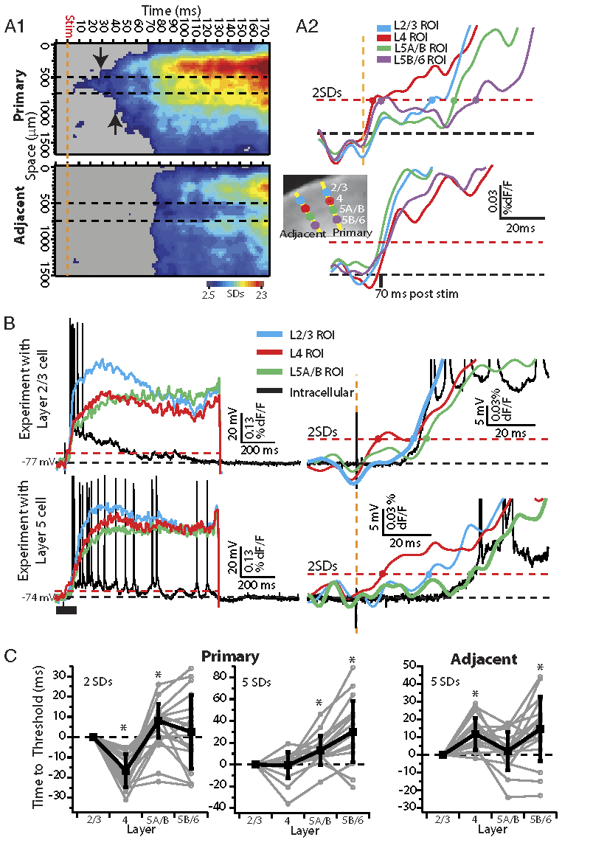
FYI…
Analysis and quantification of thalamocortical responses recorded with VSD imaging. A, Line profiles and ROI analyses for the slice in Figure 2. A1, Line profiles through the primary (top) and adjacent (bottom) columns. The 0 􏰌m represents the start of the line at the surface of the slice, and time represents the time poststimulation. The borders of L4 are bracketed by the dashed black lines and are based on measured depth from the surface. The downward arrow in the primary column line profile indicates activity invading L2/3, and the upward arrow indicates activity invading L5. The up-state travels as a wave with a single front to the adjacent column. A2, ROIs through the primary (top) and adjacent (bottom) columns. The black dashed line indicates the baseline, and the red dashed line indicates 2 SDs above baseline noise. The time to 2 SDs above baseline noise is indicated with colored dots for each ROI. The placement of line profiles and ROIs is shown over a grayscale reference image. Time of VB stimulation is marked by the dashed orange lines in all. B, Examples from two additional slices of up-state initiation in a primary column. ROIs were taken perpendicular to the surface of the slice as in part A, here centered on the site of the intracellular recording. A L2/3 cell was recorded in the top example, and a L5 cell was recorded in the bottom example. An expansion of the initial part of the response is provided at right. The time to 2 SDs above baseline noise is indicated with dots for each ROI. Note in both cases that a L4 3 L2/3 3 L5 order of activation of the primary column is apparent. Also note agreement of intracellular and VSD recordings. ROIs are from averages of multiple trials, while the intracellular recording is a representative single trial. C, Quantification of the order of activation of signals from ROIs representing cortical layers for a population of slices (n 􏰅 18). The y-axis represents the time from VB stimulation to dF/F signal crossing a threshold above baseline noise (2 SDs for initial response or 5 SDs for an up-state in progress), normalized to the time measured in L2/3. Individual trials are shown in gray, and the mean 􏰆 SD, in black. *p 􏰀 0.05, Student’s t test for difference from 0. Values are provided in text.
From WesterContreras12

Slide 28
Hello BlicketWorld!
Meet the Players
Objects (3 classes):
Boxes (2) one a blicket detector, the other not
Lights (3): green = blicket present in the immediate vicinity
yellow = could be a blicket
red = no blickets around
Potential blickets (many; 20? 50? 100?):
* vary proportion that are blickets
* vary train/test partitioning
* (advanced) add features for obj recognition
:* features object behaviors ("activity recognition")
Relations (4?):
* before (after)
:* subcategorize for long, short intervals?
* above (below)
* contiguous, i.e., "touching" (vs. not)
* contained in (vs. not)
* causality (requires both a before relation + a contiguity relation
Cover Story:
The subject is sat in front of two boxes, one of which is a blicket detector. Potential blickets are either placed into the box (activates the detector, if relevant), or placed on top (does not activate detector even if the object is a blicket.
If a blicket is detected, a green light goes off, else the detector turns on a red light if it was asked to detect. Could have an advanced case of yellow light for ambiguous, or some other state.
Subject outputs essentially all possible aspects of BlicketWorld, naming objects, categorizing blickets, identifying relations between objects, predicting lights going on/off, etc. A key focus is on “relation recognition” and then using the information in many ways. And, an important aspect is having a separate “semantic learning” module that uses verbal information (relation labels, etc.)

